Slide 1
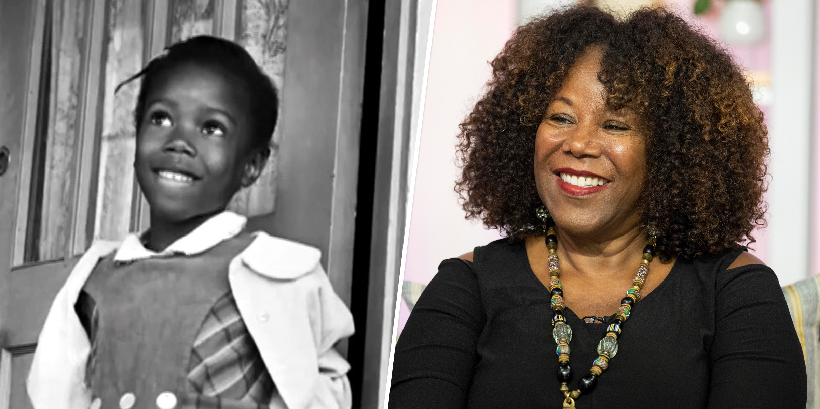
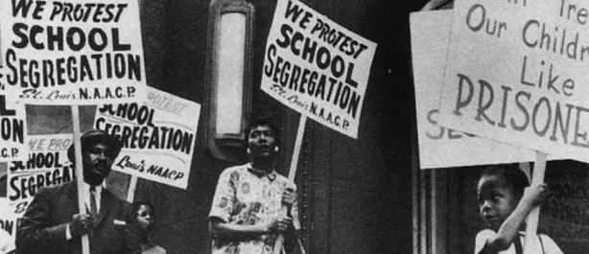
Jennifer Coleman 12/19/2022 Prof. Remi Alapo BMCC AFN 128 “MY BLACK WOMAN STORY: RUBY BRIDGES
In this presentation, regarding “My Black Woman story”. I’ll be discussing Segregation and it’s historical affect on the educational system. I will also like to talk about a courageous black woman named Ruby Bridges, (a social activist leader who was the first black woman to attend an all white school). In relation to my black woman story, I want to dedicate this discussion to my mom. She was an intelligent, genuine, and optimistic woman who became the first woman in my family to obtain her bachelors degree. Throughout the many struggles that the black women have faced, they’ve proceeded to accomplish many successful outcomes through feminism, faith, bravery, and determination.

Slide 2
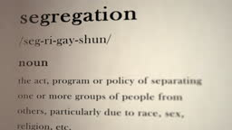
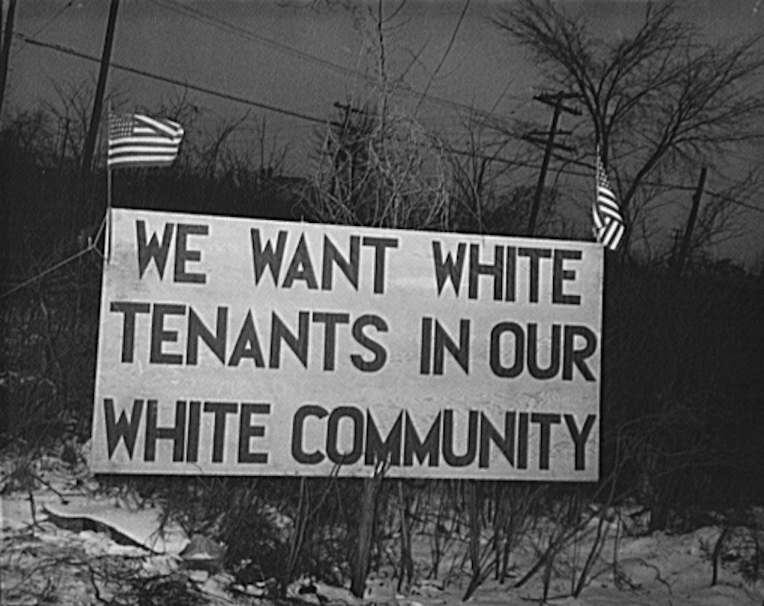
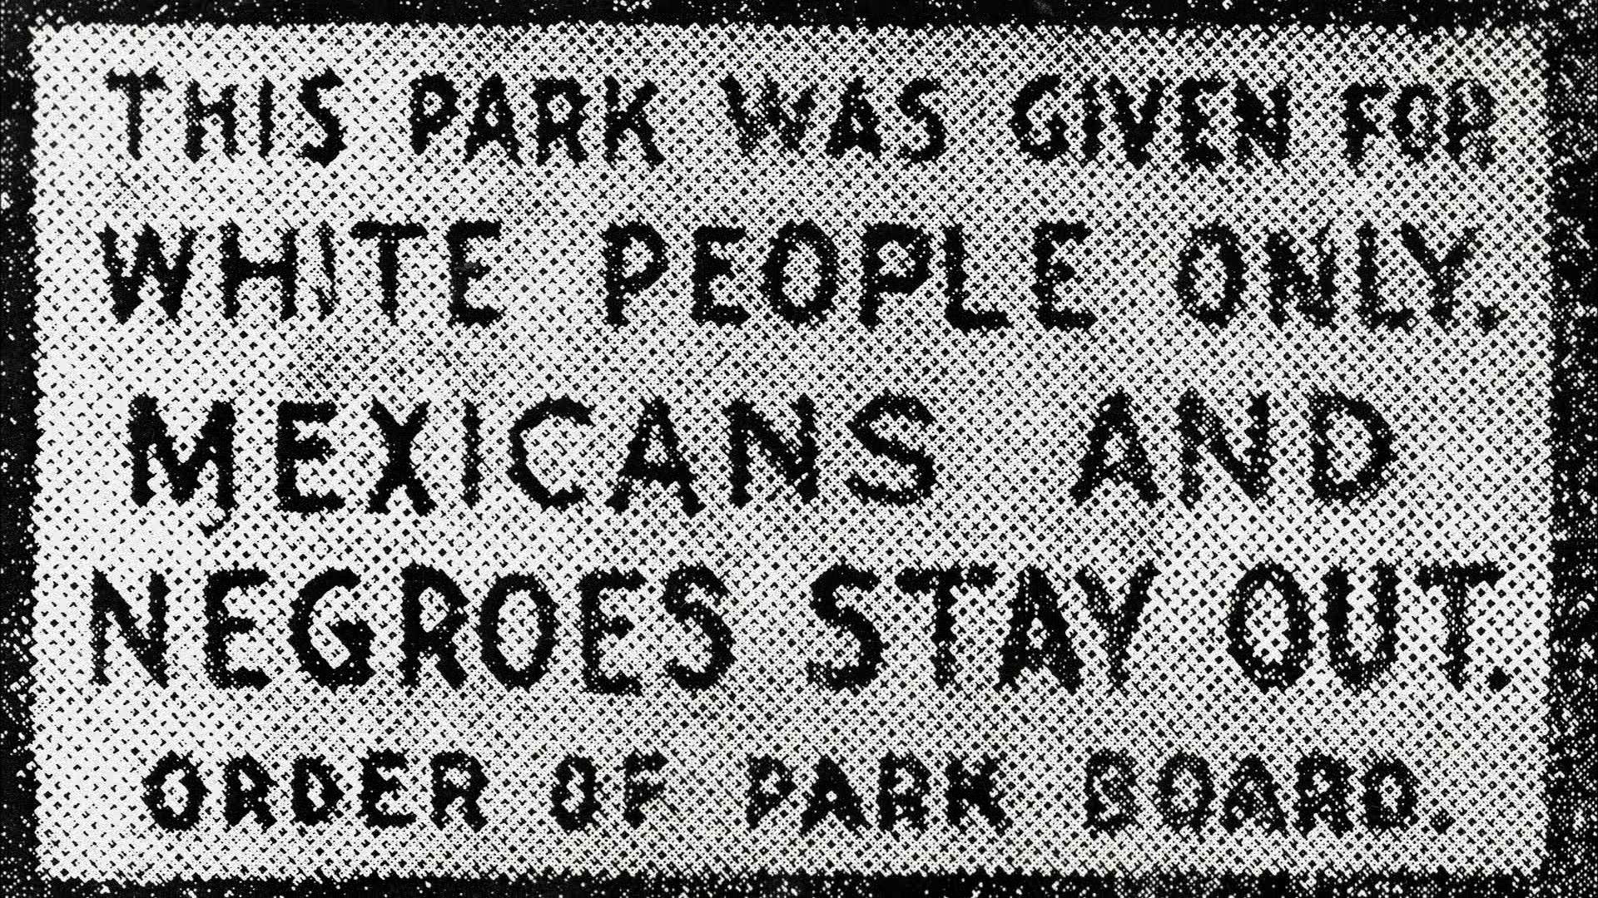
What is Segregation?
Before we get into the topic of segregation, and the effect it had on education. We must understand the definition of segregation. Segregation according to Oxford languages dictionary, is “the action or state of settling someone or something apart from others”. School segregation in the US separated students based on their race, and status. Black students would attend an all black school while white students would attend an all white school. Segregation reveals the truth about the physical separation of people in everyday activities, professional life, and in the practice of civil rights. There are a few types of Segregation Legal segregation. 1.Social segregation. 2. Gated communities. 3. Voluntary segregation, and 4. Racial segregation which is one of many types of segregation, that ranges from deliberate and systematic persecution through subtle types of discrimination to self-imposed separation.

Slide 3
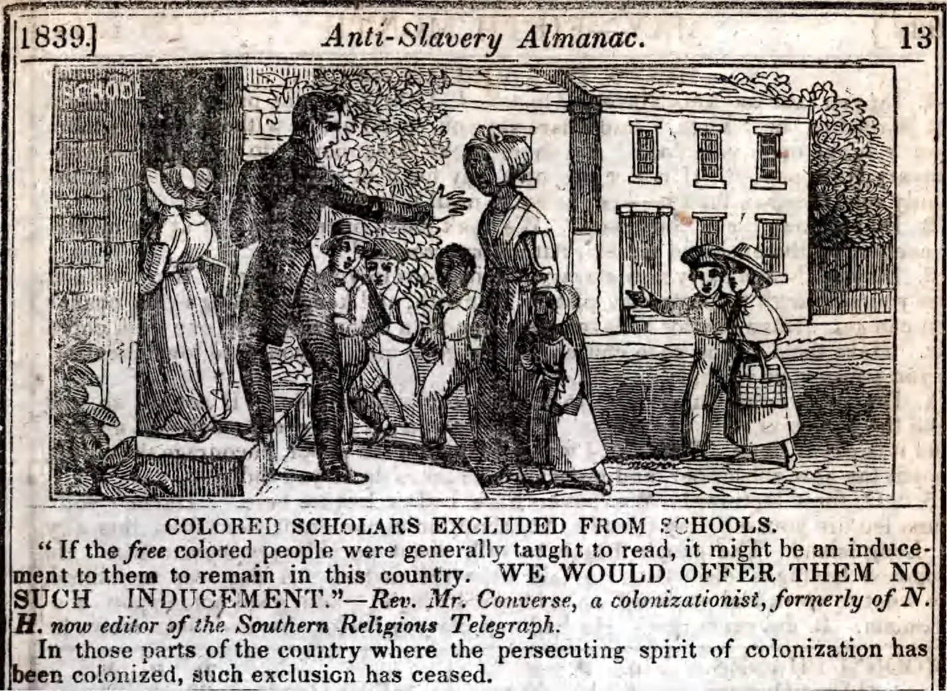
The Origin of segregation:
The origin of segregated schools dates back to the mid 1800s. In 1849 the Massachusetts Supreme Court permitted desegregation of schools under the states constitution, which then later supported the “separate but equal doctrine”, A doctrine according to the 14th amendment that did not allow racial segregation to violate the constitutional law. Although the United States Supreme Court (in the 1896 case Plessy v. Ferguson) and the North Carolina legislature had declared that separate education must be equal, it was not equal at all.

Slide 4
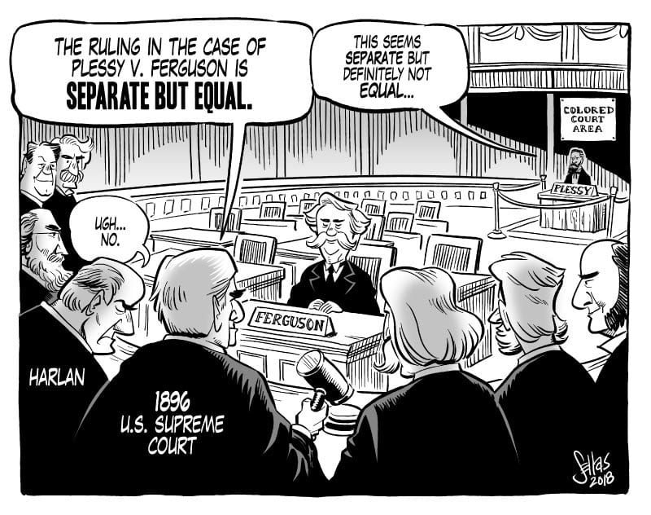
The separate but equal doctrine
This doctrine was created by the Supreme Court on May 18, 1896, and derived from the Louisiana law of 1890. Under the 14th amendment, the Supreme Court outlaw, the rule of racially separated facilities in the US. The court felt that segregation wasn’t discrimination. As long as there was equal treatment amongst races. The law affected many people of color because they weren’t getting fair treatment, even though the law rule the equality of races. They were separate, Housing, schools, facilities, labor, medical care, and public accommodations Between white and colored people. The effect of this detrimental decision heightened during the Jim Crow era in 1876. The doctrine promised equality but that rarely existed. For example, According to the Florida superintendent of public extraction, the value of white schools in the state was 70,543,000 while the African-American value was 4,900,000. Reports also states that black schools were held in churches, larges and shacks with no toiletries, water, or resources.

Slide 5
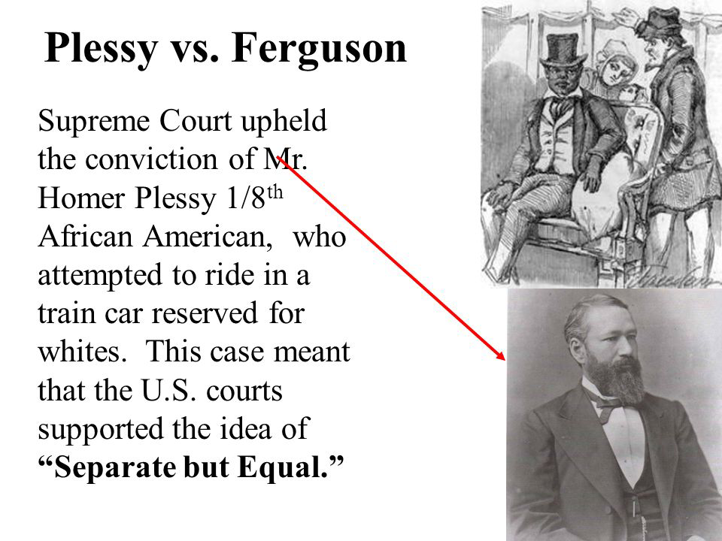
Plessy v. ferguson
In 1890 a new law in Louisiana rule the requirements of separate railroads amongst colors and whites. Many Black people became upset and decided to go against the wall. On June 7, 1892 one particular mixed race, man named Homer Plessy Refused to leave a seat reserved for whites only. Plessy Was arrested for 20 days. In court judge, Ferguson, confirm the long, and sparked the case of Plessy v. Ferguson Which caught the attention of the Supreme Court. With blacks not being able to vote and white room, and then Congress, the law of segregation continue to ruin mini colored peoples lives. The court ruled that segregationist in the US was constitutional and not discrimination.

Slide 6
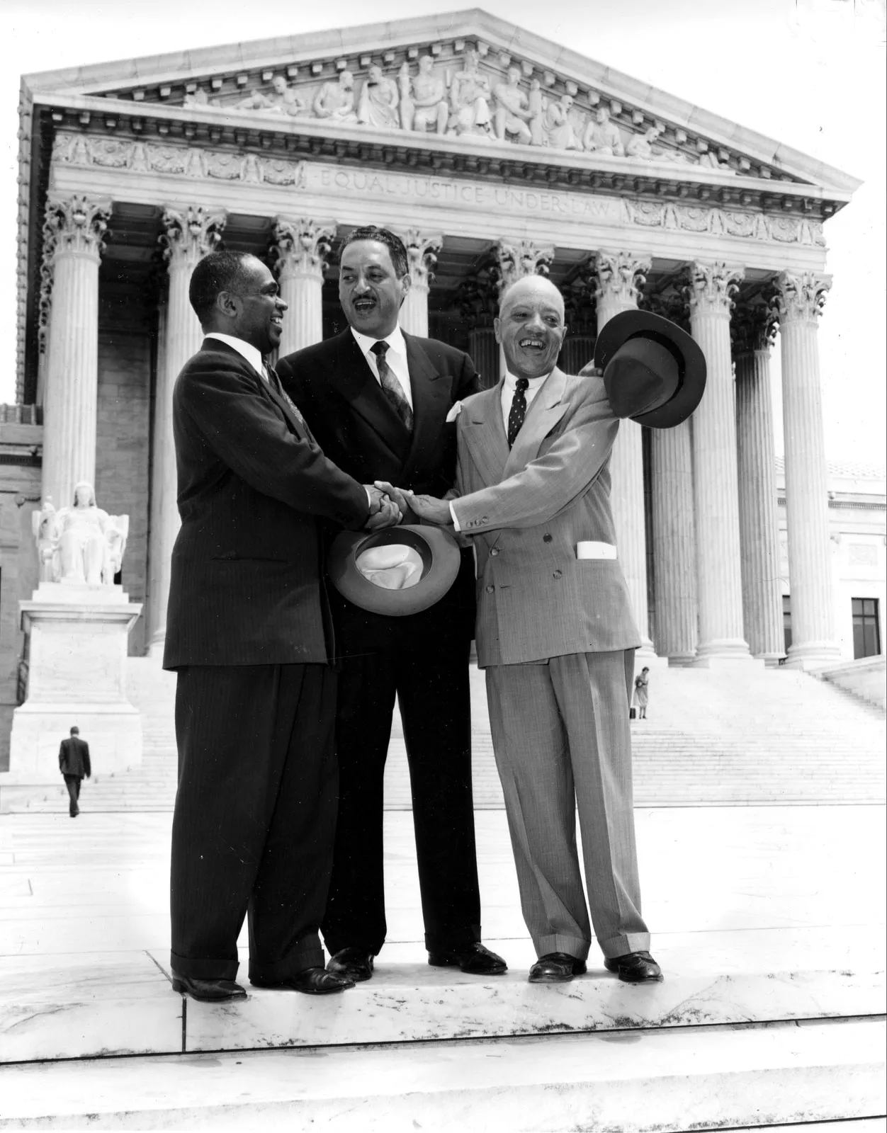
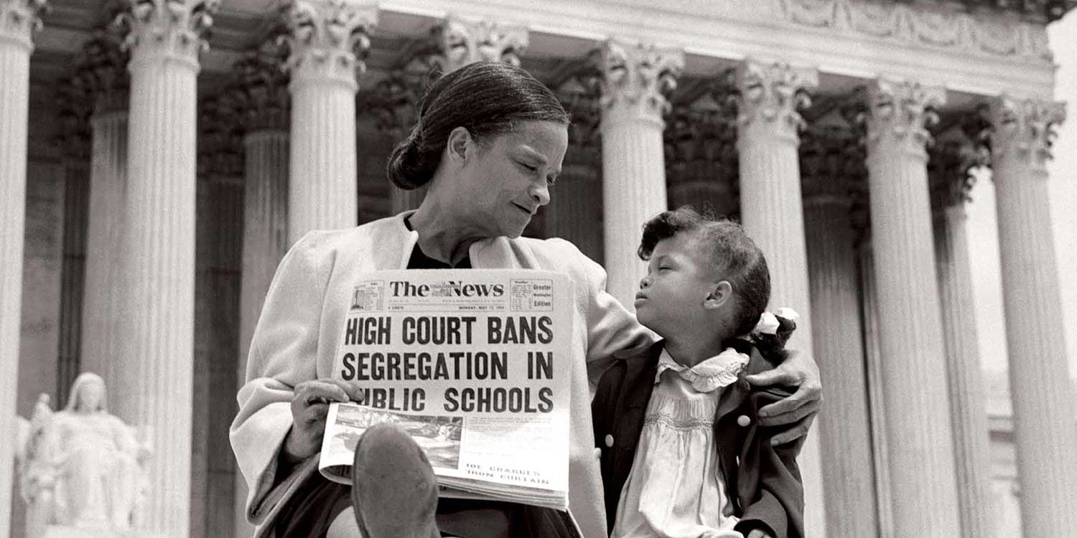
Brown v. Board of Education
Before the brown versus board case, federal appeals court strikes down segregated schools for Mexican Americans, and white students (west minister school District v. Mendez) in 1948 Because there were no law schools for blacks. The Supreme Court accepted the admission of a black student to the all white school of Law (university of Oklahoma)(Sipuel v. Board of regents of the university of Oklahoma). Since the Supreme Court rejected Texas plan to create black law schools or admit black students in all white law schools (Sweat v. Painter). A 16 year old, black student named Barbara John’s, lead 450 students in an anti-school segregation strike. In 1953 Earl Warren, became chief justice of the Supreme Court. This started the second argument in the brown versus board of education of Topeka. The courts declared that separate schools are unequal and decide to desegregate schools. In 1958, 10,000 young people marched in Washington DC to support integration.

Slide 7
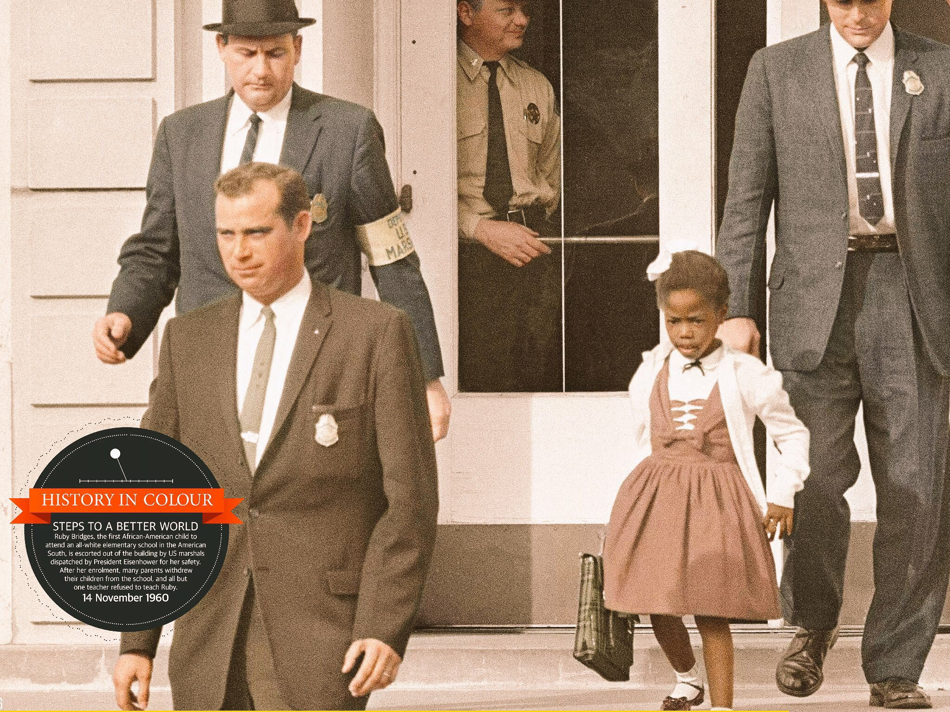
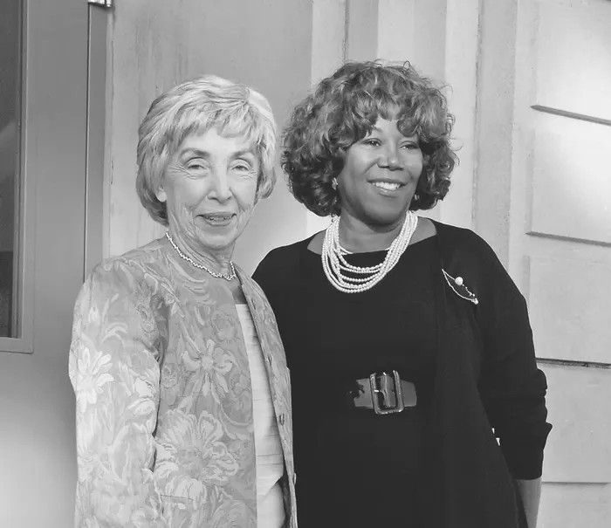
Ruby Bridges
Ruby, bridges is a black American civil rights activist. That was the first to attend an all white school after the brown v. board of education law been passed. After the fight for the segregation in schools, bridges attended William Frantz elementary school In the state of Louisiana during the crisis of desegregation on November 14, 1960. Federal marshals (Gail st, Etienne, Leona Tate, and Tessie Prevost) had to shield Ruby some angry white crowds as she enrolled in school. Why people write it against the integration of public schools, mini threatened Ruby’s life, and called her derogatory terms. Since the federal government was under pressure in 1957 the Orleans parish school board administered an entrance exam to students at Bridges school in hopes that black students wouldn’t be able to attend an all white school. Bridges, luckily passed the exam and enrolled in the Williams France elementary school. She was the only student in her classroom being taught by the only teacher who Decided to give her an opportunity at equal education. Movies family suffered greatly from the new law of integration. But as the protest subsided, White and Black people came together to support the Bridges family. Today Ruby is married with four boys, and retired from being a travel agent for 15 years. She is now the chair at ruby bridges foundation formed in 1999. As she quotes “racism is a grown-up disease and we must stop using our children to spread it”. Ruby, bridges (pg19).

Slide 8
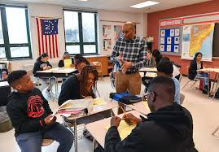
Modern day education
The nation marks the 63rd anniversary of brown versus board of education. All kids living in the United States have the right to a free public education. And the Constitution requires that all kids be given equal educational opportunity no matter what their race, ethnic background, religion, or sex, or whether they are rich or poor, citizen or non-citizen. Now schools are more diverse and less segregated. Although discrimination still exists today. Many African Americans and colored people now have the equal opportunities at facilities that they’ve been fighting for.

Slide 9
References:
Jeffrey j. Crow, Paul D. Escott, and Flora J Hatley, A History of African Americans in North Carolina (2002)
Sarah-Soonling Blackburn, Brown v. Board: Timeline of school integration in the U.S. (2004)
Andersson, James; Byrne, Dara N. (2004). The unfinished Agenda of Brown v. Board of Education. Hoboken, NJ: J. Wiley & Sons. (P 169).
Michals, Debra (2015). “ Ruby Bridges. National women’s history museum. Retrieved Nov 15 2018.

Slide 10
Works Cited:
Bridges, Ruby smell” The Education of Ruby Nell” Ruby Bridges Foundation 2000. Accessed Feb 2,2015.

